Slide 1
Classification and Logistic Regression Chapter 4
In this chapter, we study approaches for predicting qualitative responses, a process that is known as classification. Predicting a qualitative response for an observation can be referred to as classifying that observation, since it involves assigning the observation to a category, or class.

Slide 2
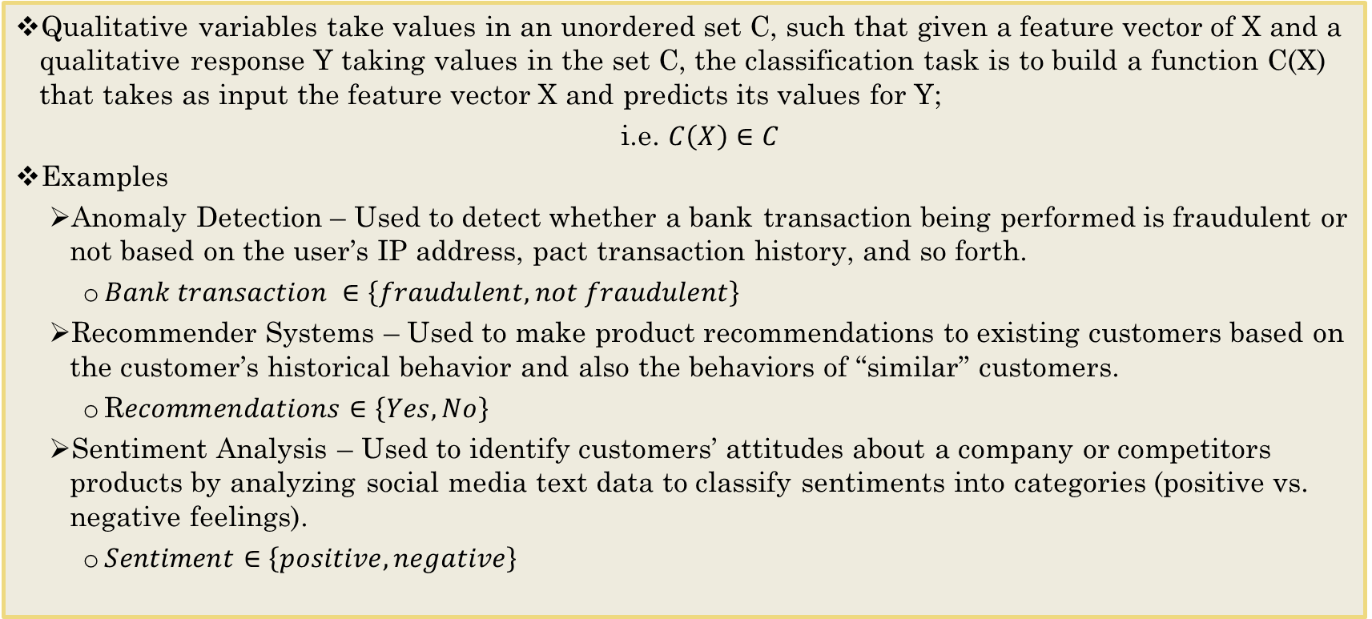
Overview of Classification
Qualitative variables take values in an unordered set C, such that given a feature vector of X and a qualitative response Y taking values in the set C, the classification task is to build a function C(X) that takes as input the feature vector X and predicts its values for Y;
i.e. $C\left(X\right)∈C$
Examples
Anomaly Detection – Used to detect whether a bank transaction being performed is fraudulent or not based on the user’s IP address, pact transaction history, and so forth.
$Bank transaction ∈\left\{fraudulent, not fraudulent\right\}$
Recommender Systems – Used to make product recommendations to existing customers based on the customer’s historical behavior and also the behaviors of “similar” customers.
R$ecommendations∈\left\{Yes, No\right\}$
Sentiment Analysis – Used to identify customers’ attitudes about a company or competitors products by analyzing social media text data to classify sentiments into categories (positive vs. negative feelings).
$Sentiment∈\left\{positive, negative\right\}$

Slide 3
Classification
Often we are more interested in estimating the probabilities that X belongs in each category in C.
For example, it is more valuable to have an estimate of the probability that an insurance claim is fraudulent than a classification fraudulent or not.

Slide 4
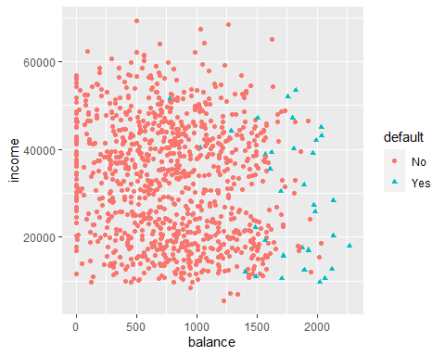
An Example With Default Dataset
library(ISLR) data(Default) str(Default)
## 'data.frame': 10000 obs. of 4 variables: ## $ default: Factor w/ 2 levels "No","Yes": 1 1 1 1 1 1 1 1 1 1 ... ## $ student: Factor w/ 2 levels "No","Yes": 1 2 1 1 1 2 1 2 1 1 ... ## $ balance: num 730 817 1074 529 786 ... ## $ income : num 44362 12106 31767 35704 38463 ...
library(ggplot2)
ggplot(Default, aes(balance, income, group=default))+geom_point(aes(shape=default, color=default))

Slide 5
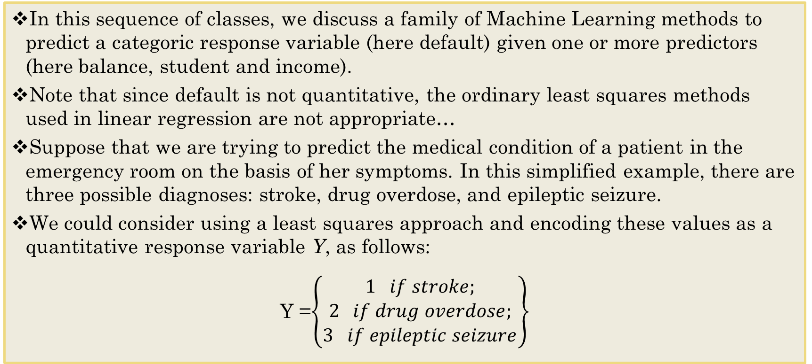
Why Not Linear Regression?
In this sequence of classes, we discuss a family of Machine Learning methods to predict a categoric response variable (here default) given one or more predictors (here balance, student and income).
Note that since default is not quantitative, the ordinary least squares methods used in linear regression are not appropriate…
Suppose that we are trying to predict the medical condition of a patient in the emergency room on the basis of her symptoms. In this simplified example, there are three possible diagnoses: stroke, drug overdose, and epileptic seizure.
We could consider using a least squares approach and encoding these values as a quantitative response variable Y, as follows:
Y =$\left\{\begin{matrix}1 if stroke; \\ 2 if drug overdose; \\ 3 if epileptic seizure\end{matrix}\right\}$

Slide 6
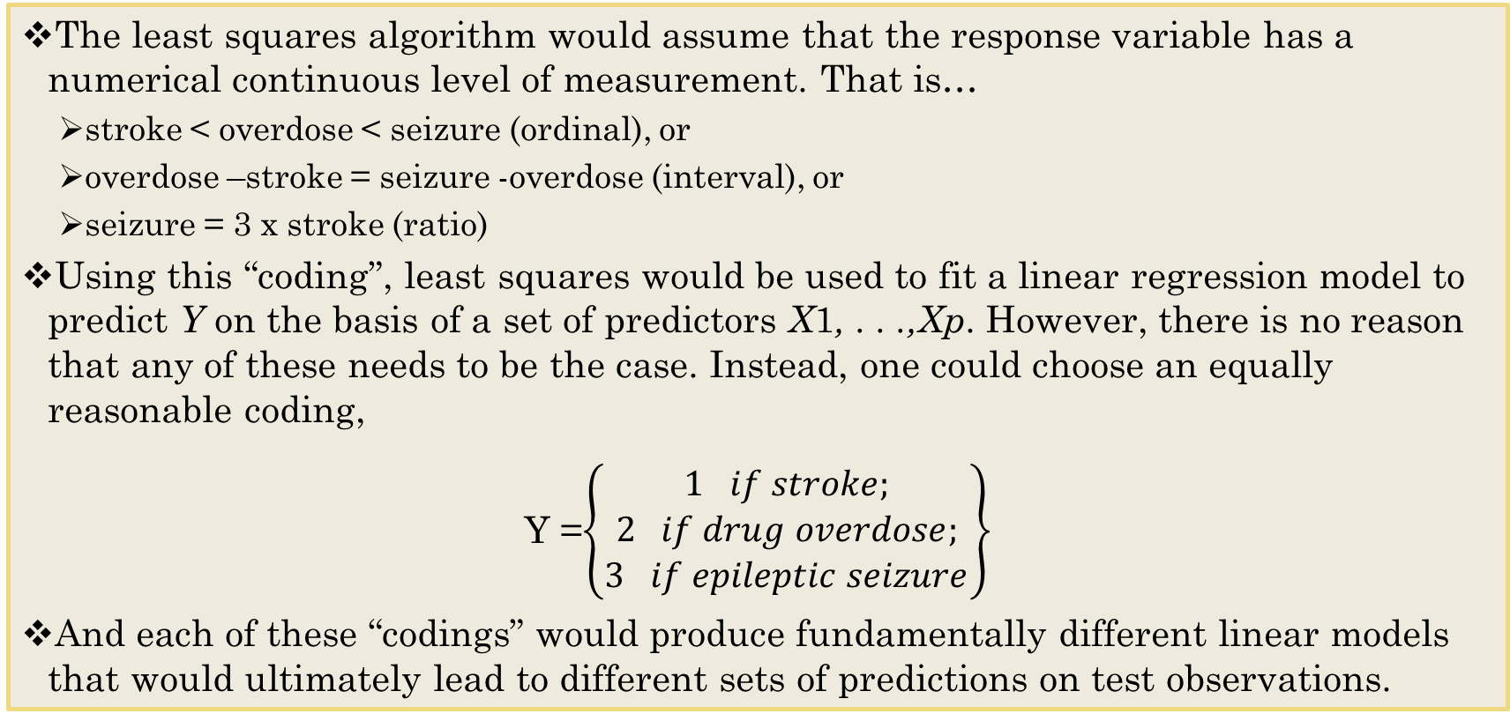
Why Not Linear Regression?
The least squares algorithm would assume that the response variable has a numerical continuous level of measurement. That is…
stroke < overdose < seizure (ordinal), or
overdose –stroke = seizure -overdose (interval), or
seizure = 3 x stroke (ratio)
Using this “coding”, least squares would be used to fit a linear regression model to predict Y on the basis of a set of predictors X1, . . .,Xp. However, there is no reason that any of these needs to be the case. Instead, one could choose an equally reasonable coding,
Y =$\left\{\begin{matrix}1 if stroke; \\ 2 if drug overdose; \\ 3 if epileptic seizure\end{matrix}\right\}$
And each of these “codings” would produce fundamentally different linear models that would ultimately lead to different sets of predictions on test observations.

Slide 7
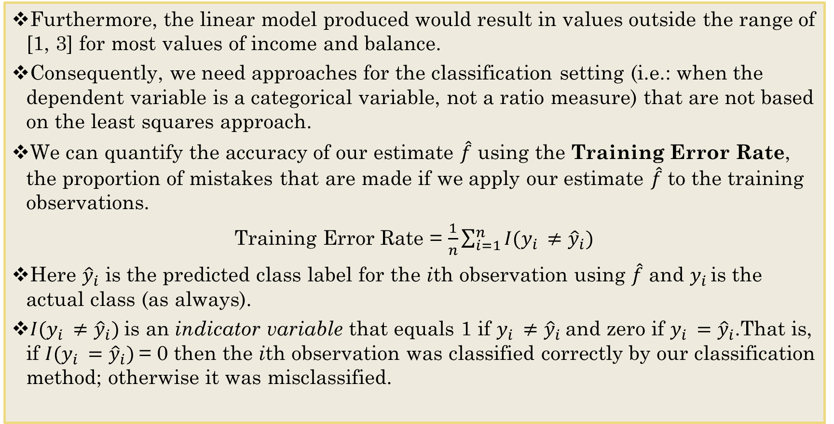
Why Not Linear Regression? Cont.
Furthermore, the linear model produced would result in values outside the range of [1, 3] for most values of income and balance.
Consequently, we need approaches for the classification setting (i.e.: when the dependent variable is a categorical variable, not a ratio measure) that are not based on the least squares approach.
We can quantify the accuracy of our estimate $\hat{\text{f}}$ using the Training Error Rate, the proportion of mistakes that are made if we apply our estimate $\hat{\text{f}}$ to the training observations.
Training Error Rate = $\frac{1}{n}\sum_{i=1}^{n}{I(y_{i }≠{\hat{y}}_{i})}$
Here ${\hat{y}}_{i}$ is the predicted class label for the ith observation using $\hat{\text{f}}$ and $y_{i }$is the actual class (as always).
$I(y_{i }≠{\hat{y}}_{i})$is an indicator variable that equals 1 if $y_{i }≠{\hat{y}}_{i}$and zero if $y_{i }={\hat{y}}_{i}$.That is, if $I(y_{i }={\hat{y}}_{i})$= 0 then the ith observation was classified correctly by our classification method; otherwise it was misclassified.

Slide 8
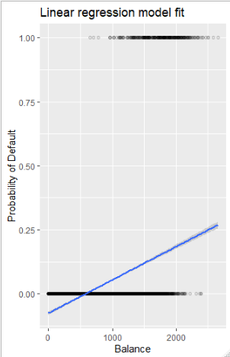
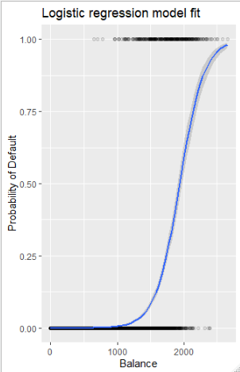
Plotting Linear Regression vs Logistic Regression
Not appropriate here.

Slide 9
The Classification Case
As in the regression setting, we are most interested in the error rates that result from applying our classifier to observations that were not used in training –that is, test data, not training data.
We compute a Test Error Rate using the same expression, but of course we now use test observations.
A good classifier is one for which the test error is smallest.

Slide 10
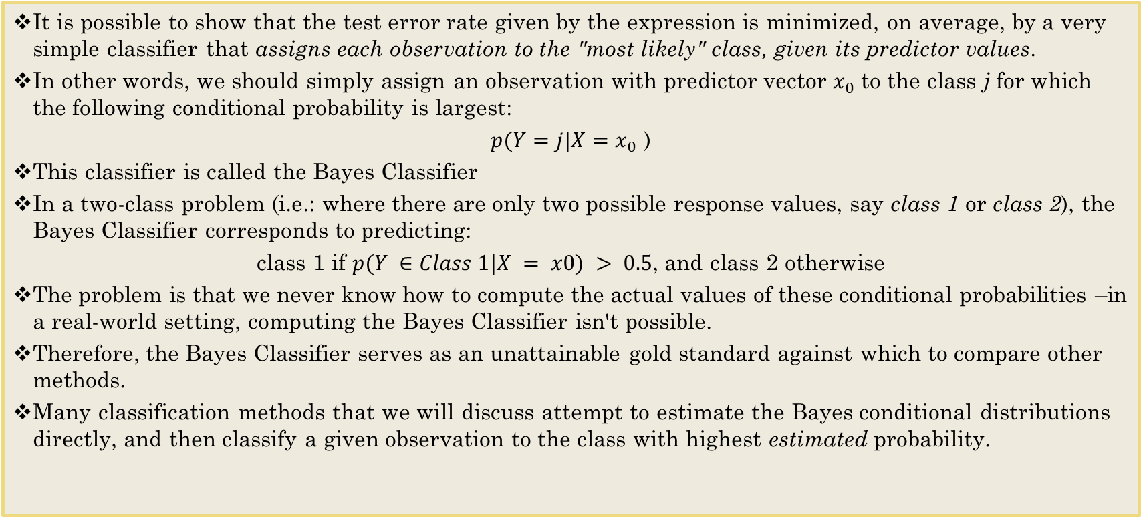
The Bayes Classifier
It is possible to show that the test error rate given by the expression is minimized, on average, by a very simple classifier that assigns each observation to the "most likely" class, given its predictor values.
In other words, we should simply assign an observation with predictor vector $x_{0}$ to the class j for which the following conditional probability is largest:
$p(Y=j|X=$ $x_{0}$ )
This classifier is called the Bayes Classifier
In a two-class problem (i.e.: where there are only two possible response values, say class 1 or class 2), the Bayes Classifier corresponds to predicting:
class 1 if $p(Y ∈Class 1|X = x0) > 0.5$, and class 2 otherwise
The problem is that we never know how to compute the actual values of these conditional probabilities –in a real-world setting, computing the Bayes Classifier isn't possible.
Therefore, the Bayes Classifier serves as an unattainable gold standard against which to compare other methods.
Many classification methods that we will discuss attempt to estimate the Bayes conditional distributions directly, and then classify a given observation to the class with highest estimated probability.

Slide 11
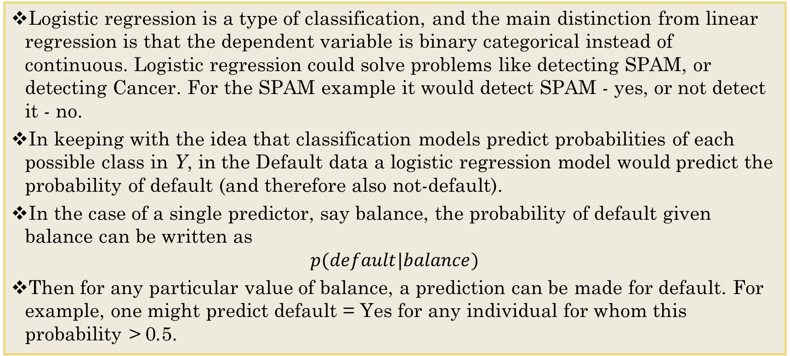
Logistic Regression
Logistic regression is a type of classification, and the main distinction from linear regression is that the dependent variable is binary categorical instead of continuous. Logistic regression could solve problems like detecting SPAM, or detecting Cancer. For the SPAM example it would detect SPAM - yes, or not detect it - no.
In keeping with the idea that classification models predict probabilities of each possible class in Y, in the Default data a logistic regression model would predict the probability of default (and therefore also not-default).
In the case of a single predictor, say balance, the probability of default given balance can be written as
$$p(default|balance)$$
Then for any particular value of balance, a prediction can be made for default. For example, one might predict default = Yes for any individual for whom this probability > 0.5.

Slide 12
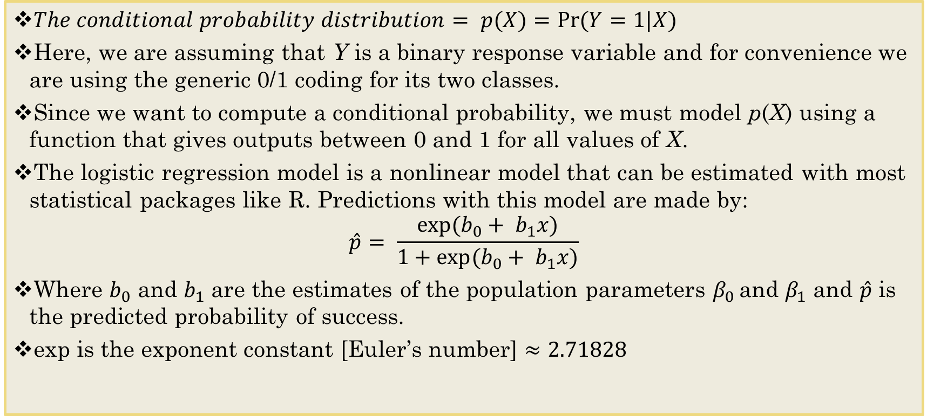
The Logistic Regression Function
$The conditional probability distribution= p(X)=Pr⁡(Y=1|X)$
Here, we are assuming that Y is a binary response variable and for convenience we are using the generic 0/1 coding for its two classes.
Since we want to compute a conditional probability, we must model p(X) using a function that gives outputs between 0 and 1 for all values of X.
The logistic regression model is a nonlinear model that can be estimated with most statistical packages like R. Predictions with this model are made by:
$$\hat{p}= \frac{exp⁡(b_{0}+ b_{1}x)}{1+exp⁡(b_{0}+ b_{1}x)}$$
Where $b_{0}$ and $b_{1}$ are the estimates of the population parameters $β_{0 }$and $β_{1}$ and $\hat{p}$ is the predicted probability of success.
exp is the exponent constant [Euler’s number] $≈2.71828$
Transformation to model probabilities on a non-linear scale

Slide 13
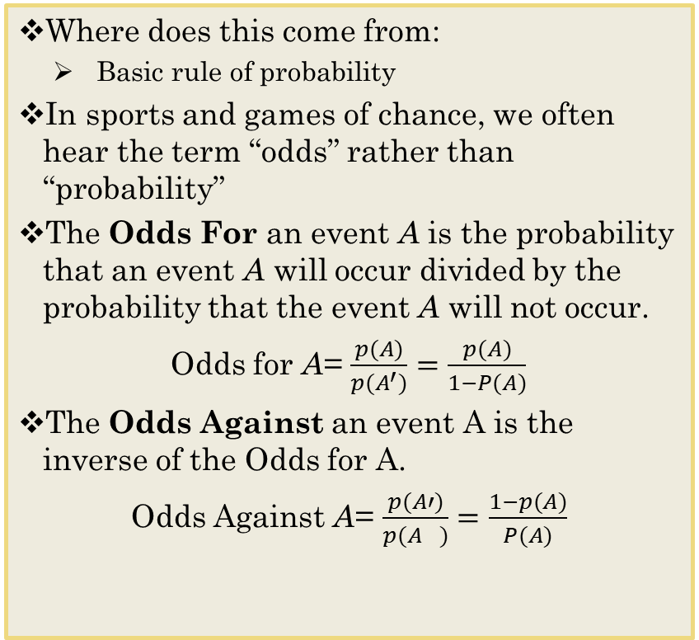
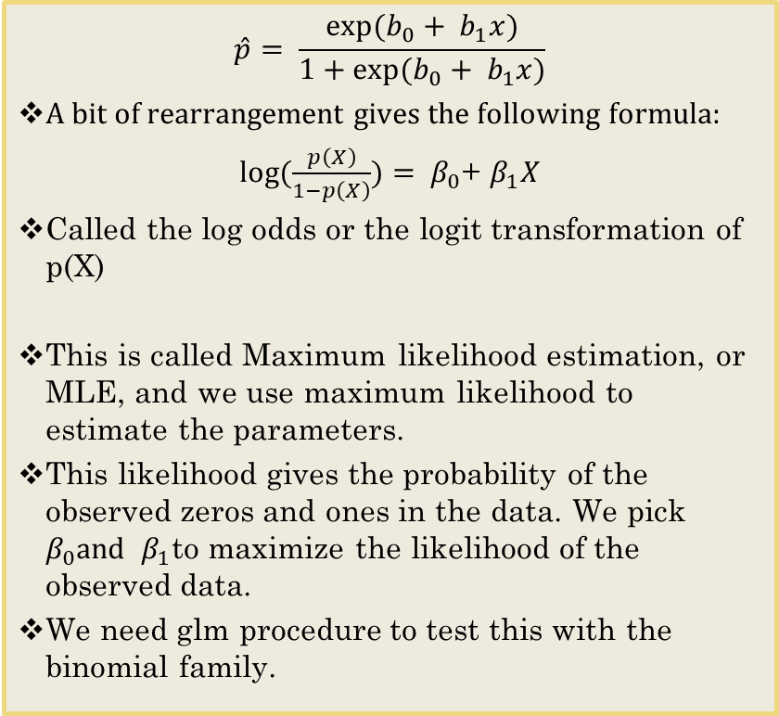
Monotone Transformation
$$\hat{p}= \frac{exp⁡(b_{0}+ b_{1}x)}{1+exp⁡(b_{0}+ b_{1}x)}$$
A bit of rearrangement gives the following formula:
$log⁡(\frac{p\left(X\right)}{1−p\left(X\right)})= β_{0}$+ $β_{1}X$
Called the log odds or the logit transformation of p(X)
This is called Maximum likelihood estimation, or MLE, and we use maximum likelihood to estimate the parameters.
This likelihood gives the probability of the observed zeros and ones in the data. We pick $β_{0}and$ $β_{1}$to maximize the likelihood of the observed data.
We need glm procedure to test this with the binomial family.
Where does this come from:
Basic rule of probability
In sports and games of chance, we often hear the term “odds” rather than “probability”
The Odds For an event A is the probability that an event A will occur divided by the probability that the event A will not occur.
Odds for A= $\frac{p(A)}{p(A^{′})}=\frac{p(A)}{1−P(A)}$
The Odds Against an event A is the inverse of the Odds for A.
Odds Against A= $\frac{p(A′)}{p(A^{})}=\frac{1−p(A)}{P(A)}$

Slide 14
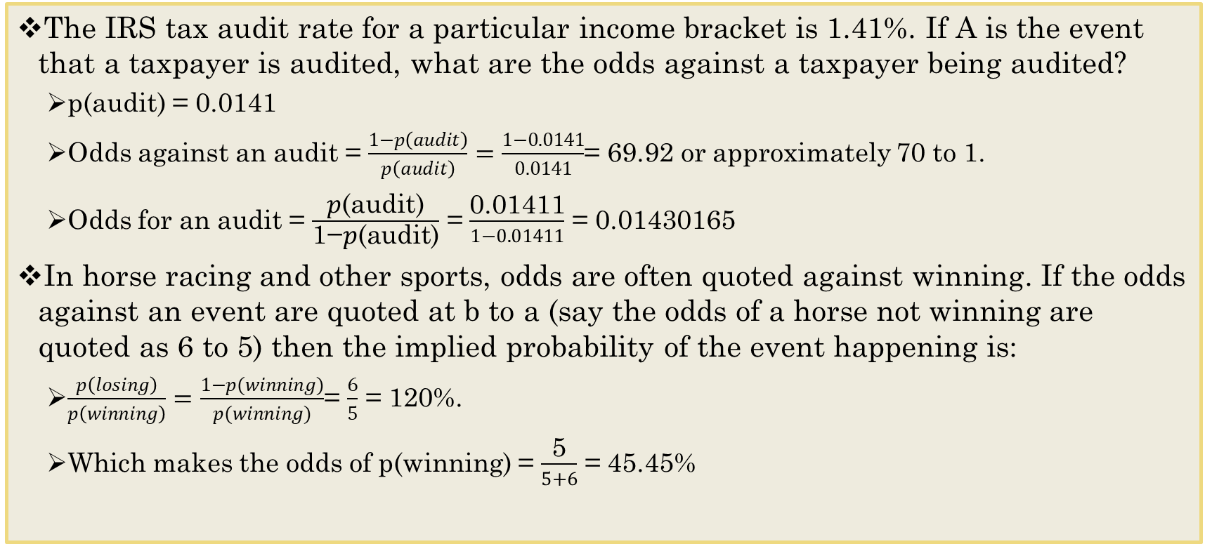
Example of general probability rules
The IRS tax audit rate for a particular income bracket is 1.41%. If A is the event that a taxpayer is audited, what are the odds against a taxpayer being audited?
p(audit) = 0.0141
Odds against an audit = $\frac{1−p\left(audit\right)}{p\left(audit\right)}=\frac{1−0.0141}{0.0141}$= 69.92 or approximately 70 to 1.
Odds for an audit = $\frac{\text{p}\text{(}\text{audit}\text{)}}{\text{1−}\text{p}\text{(}\text{audit}\text{)}}$ = $\frac{\text{0.01411}}{1−0.01411}$ = 0.01430165
In horse racing and other sports, odds are often quoted against winning. If the odds against an event are quoted at b to a (say the odds of a horse not winning are quoted as 6 to 5) then the implied probability of the event happening is:
$\frac{p\left(losing\right)}{p\left(winning\right)}=\frac{1−p(winning)}{p(winning)}$= $\frac{6}{5}$ = 120%.
Which makes the odds of p(winning) = $\frac{\text{5}}{5+6}$ = 45.45%
(1-.4545) / .4545

Slide 15
Separating the Data
Setting the Seed before dividing data ensures consistent results.
A more advanced technique over the Sample function is with the Caret package, used to create a data partition. A higher sample size of data in the training group will help you make better predictions.
divideData <- createDataPartition(Default$default, p = 0.9, list = FALSE) ##Move the amount in the training set to a higher percentage. train <- Default[divideData,] test <- Default[-divideData,]

Slide 16
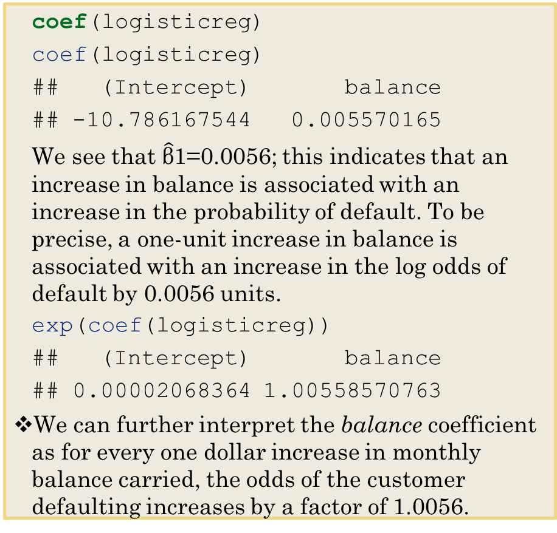
logisticreg <- glm(default~balance, family=binomial, data=train) summary(logisticreg)
## Call: ## glm(formula = default ~ balance, family = binomial, data = train) ## ## Deviance Residuals: ## Min 1Q Median 3Q Max ## -2.2841 -0.1409 -0.0562 -0.0210 3.7138 ## ## Coefficients: ## Estimate Std. Error z value Pr(>|z|) ## (Intercept) -10.7861675 0.4095312 -26.34 <2e-16 *** ## balance 0.0055702 0.0002483 22.43 <2e-16 *** ## --- ## Signif. codes: 0 '***' 0.001 '**' 0.01 '*' 0.05 '.' 0.1 ' ' 1 ## ## (Dispersion parameter for binomial family taken to be 1) ## ## Null deviance: 2340.6 on 8000 degrees of freedom ## Residual deviance: 1240.3 on 7999 degrees of freedom ## AIC: 1244.3 ## ## Number of Fisher Scoring iterations: 8
coef(logisticreg)
coef(logisticreg)
## (Intercept) balance ## -10.786167544 0.005570165
We see that $\hat{\text{β}}$1=0.0056; this indicates that an increase in balance is associated with an increase in the probability of default. To be precise, a one-unit increase in balance is associated with an increase in the log odds of default by 0.0056 units.
exp(coef(logisticreg))
## (Intercept) balance ## 0.00002068364 1.00558570763
We can further interpret the balance coefficient as for every one dollar increase in monthly balance carried, the odds of the customer defaulting increases by a factor of 1.0056.

Slide 17
Where do These numbers come from
## Coefficients: ## Estimate Std. Error z value Pr(>|z|) ## (Intercept) -10.7861675 0.4095312 -26.34 <2e-16 *** ## balance 0.0055702 0.0002483 22.43 <2e-16 ***
coef(logisticreg)
## (Intercept) balance ## -10.786167544 0.005570165
exp(coef(logisticreg))
## (Intercept) balance ## 0.00002068364 1.00558570763
b0 <- logisticreg$coefficients[1]; b0
## (Intercept) ## -10.78617
b1 <- logisticreg$coefficients[2]; b1
## balance ## 0.005570165
probdefault <- exp(b0+b1)/(1+exp(b0 + b1)); probdefault
## 0.00002079874
log(probdefault/(1-probdefault))
## -10.7806
b0+b1
## -10.7806

Slide 18
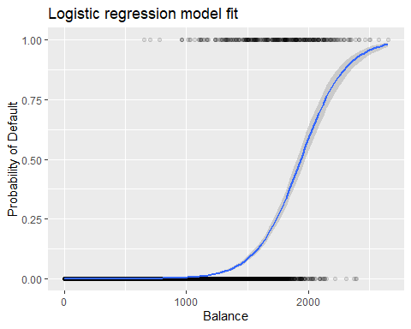
The Predicted Probabilities using logistic regression
For low balances we predict the probability of default as close to, but never below, zero.
For high balances we predict a default probability close to, but never above, one.
The logistic function 𝑝𝑋will always produce an S-shaped surface of this form, and so regardless of the value of X, we will obtain a sensible prediction.
library(tidyverse)
prob <- ifelse(Default$default == "Yes", 1, 0) ggplot(Default, aes(balance, prob)) + geom_point(alpha = .1) + geom_smooth(method = "glm", method.args = list(family = "binomial")) + ggtitle("Logistic regression model fit") + xlab("Balance") + ylab("Probability of Default")
## `geom_smooth()` using formula 'y ~ x'

Slide 19
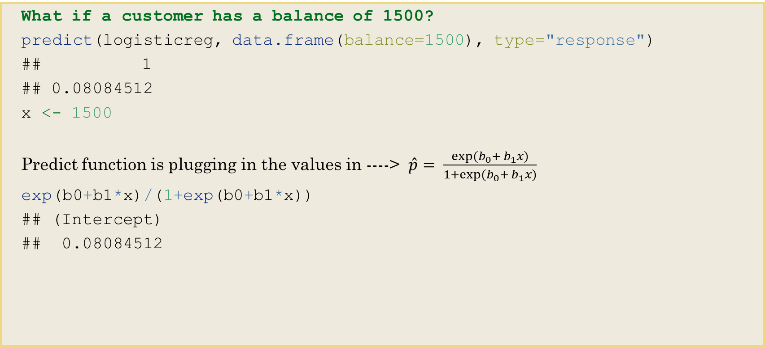
Making Predictions
What if a customer has a balance of 1500?
predict(logisticreg, data.frame(balance=1500), type="response")
## 1 ## 0.08084512
x <- 1500
Predict function is plugging in the values in ----> $\hat{p}= \frac{exp⁡(b_{0}+ b_{1}x)}{1+exp⁡(b_{0}+ b_{1}x)}$
exp(b0+b1*x)/(1+exp(b0+b1*x))
## (Intercept) ## 0.08084512

Slide 20
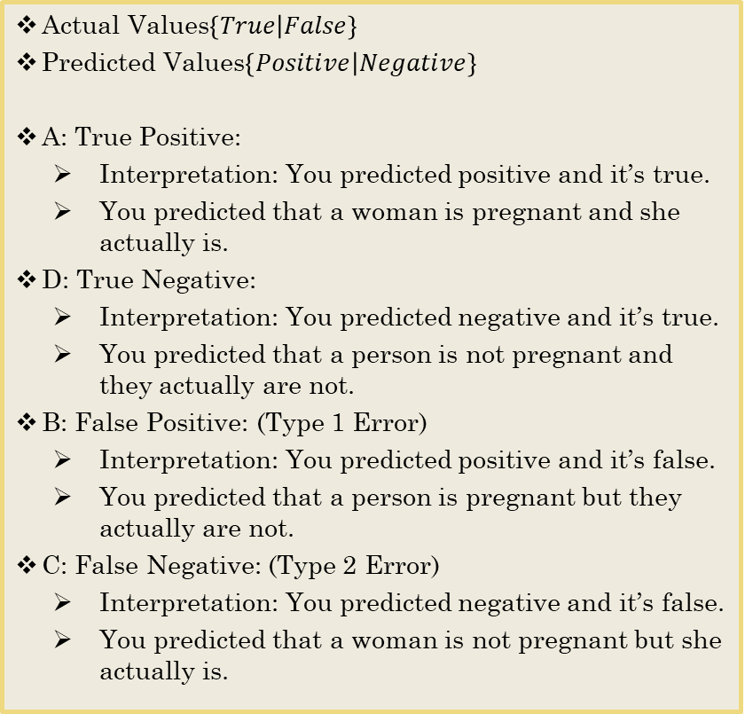
THE CONFUSION MATRIX
A binary classifier can make two types of errors. Using the Default data as an example:
It can incorrectly assign an individual who defaults to the no default category, or
It can incorrectly assign an individual who does not default to the default category.
It is often of interest to determine which of these two types of errors are being made. A confusion matrix is a convenient way to display this information
Actual Values$\left\{True | False\right\}$
Predicted Values$\left\{Positive | Negative\right\}$
A: True Positive:
Interpretation: You predicted positive and it’s true.
You predicted that a woman is pregnant and she actually is.
D: True Negative:
Interpretation: You predicted negative and it’s true.
You predicted that a person is not pregnant and they actually are not.
B: False Positive: (Type 1 Error)
Interpretation: You predicted positive and it’s false.
You predicted that a person is pregnant but they actually are not.
C: False Negative: (Type 2 Error)
Interpretation: You predicted negative and it’s false.
You predicted that a woman is not pregnant but she actually is.
 | Reference
Predicted | Event | No Event
Event | A | B
No Event | C | D

Slide 21
Calculating Testing Rate
probs<-predict(logisticreg, test, type="response") pred<-ifelse(probs>.5, "Yes", "No") table(pred, test$default)
## ## pred No Yes ## No 1927 52 ## Yes 6 14
mean(pred!=test$default) ##testing error rate
## [1] 0.02901451
(6+52)/1999
## [1] 0.02901451
mean(pred==test$default)
## [1] 0.9709855

Slide 22
Including More than 1 Predictor
multilogistic<-glm(default~.-income, family=binomial, data=train) summary(multilogistic)
## Call: ## glm(formula = default ~ . - income, family = binomial, data = train) ## ## Deviance Residuals: ## Min 1Q Median 3Q Max ## -2.4717 -0.1362 -0.0530 -0.0192 3.6974 ## ## Coefficients: ## Estimate Std. Error z value Pr(>|z|) ## (Intercept) -10.8959459 0.4191105 -25.998 < 2e-16 *** ## studentYes -0.7096734 0.1673412 -4.241 0.0000223 *** ## balance 0.0058144 0.0002619 22.198 < 2e-16 *** ## --- ## Signif. codes: 0 '***' 0.001 '**' 0.01 '*' 0.05 '.' 0.1 ' ' 1 ## ## (Dispersion parameter for binomial family taken to be 1) ## ## Null deviance: 2340.6 on 8000 degrees of freedom ## Residual deviance: 1221.3 on 7998 degrees of freedom ## AIC: 1227.3 ## ## Number of Fisher Scoring iterations: 8
exp(coef(multilogistic))
## (Intercept) studentYes balance ## 0.00001853322 0.49180481131 1.00583131998
probs<-predict(multilogistic, test, type="response") pred<-ifelse(probs>.5, "Yes","No") table(pred, test$default)
## ## pred No Yes ## No 1928 50 ## Yes 5 16
mean(pred!=test$default) ##testing error rate
## [1] 0.02751376
mean(pred==test$default) ##test success rate
## [1] 0.9724862

Slide 23
Getting New Test Error Rate
probs <- predict(multilogisticreg, test, type="response") pred<-ifelse(probs>.5,"Yes","No") table(pred, test$default)
## ## pred No Yes ## No 962 23 ## Yes 4 10
mean(pred!=test$default) ##test error rate
## [1] 0.02702703

Slide 24
Some Rules and Considerations for Logistic Regression
Logistic regression does not make many of the assumptions of linear regression and general linear models that are based on ordinary least squares algorithms – particularly regarding linearity, normality, homoscedasticity, and measurement level.
A logistic regression should include a binary dependent variable. Reducing categories to satisfy this can cause a loss of information, which makes this test inferior. If that is the case, move to a different type of classification that can handle more than 2 classes.
Logistic regression can handle ordinal and/or nominal data as predictor variables.
Notes:
First, logistic regression does not require a linear relationship between the dependent and independent variables. Second, the error terms (residuals) do not need to be normally distributed. Third, homoscedasticity is not required. Finally, the dependent variable in logistic regression is not measured on an interval or ratio scale.

Slide 25
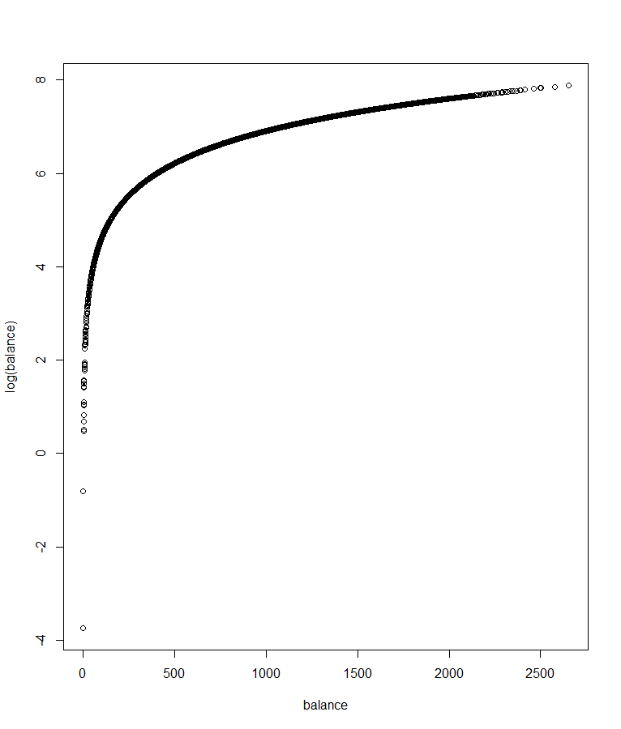
Assumption 1: Linearity of the Logit
A first assumption is linearity in the logit for any continuous independent variables (e.g., balance), meaning there should be a linear relationship between these variables and their respective logit-transformed outcomes.
It requires the independent variables are linearly related to the log-odds.
We could graph each of these pairings
attach(Default); plot(balance, log(balance))
We could create a statistical term representing the interaction between each continuous independent variable and its natural logarithm. If any of these terms is statistically significant, the assumption is violated.
interaction <- balance*log(balance) multilogistic<-glm(default~interaction, family=binomial, data=Default) summary(multilogistic)
## Coefficients: ## Estimate Std. Error z value Pr(>|z|) ## (Intercept) -9.6829918 0.3186285 -30.39 <2e-16 *** ## interaction 0.0006615 0.0000262 25.25 <2e-16 ***

Slide 26
Assumption 2: Absence of Multicollinearity
A second assumption is the absence of multicollinearity, or redundancy, among independent variables
Could evaluate with VIF score.
car::vif(multilogistic)
## student balance ## 1.081855 1.081855

Slide 27
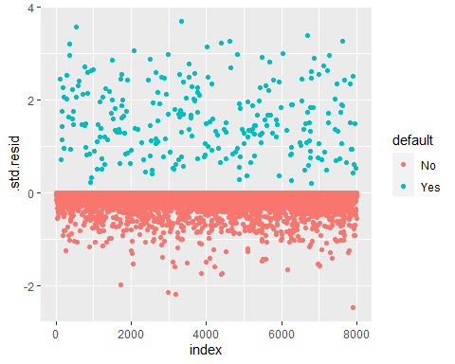
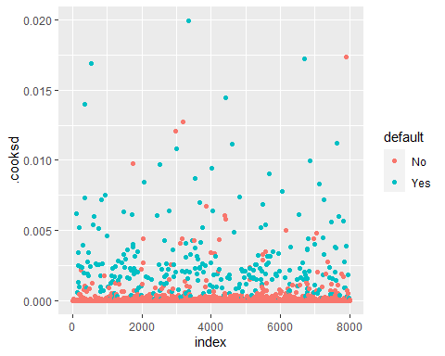
Assumption 3: Lack of Strongly Influential Outliers
A third assumption is lack of strongly influential outliers, whereby a sample member’s predicted outcome may be vastly different from his or her actual outcome.
library(broom) library(tidyverse)
# Extract model results modelResults <- augment(multilogistic) %>% mutate(index = 1:n())
ggplot(modelResults, aes(index, .std.resid))+geom_point(aes(color=default))
ggplot(modelResults, aes(index, .cooksd))+geom_point(aes(color=default))

Slide 28
Assumption 4: Independence of Errors
A last assumption is independence of errors, whereby all sample group outcomes are separate from each other and there are no duplicate responses. If one’s data include repeated measures or other correlated outcomes, errors will be similarly correlated, and the assumption is violated.
Visual check to see if data includes repeated measures.

Slide 29
To Do
Work through Logistic Regression Swirl

